Slide 1
Refraction Lab (Mr. Konichek)

Slide 2
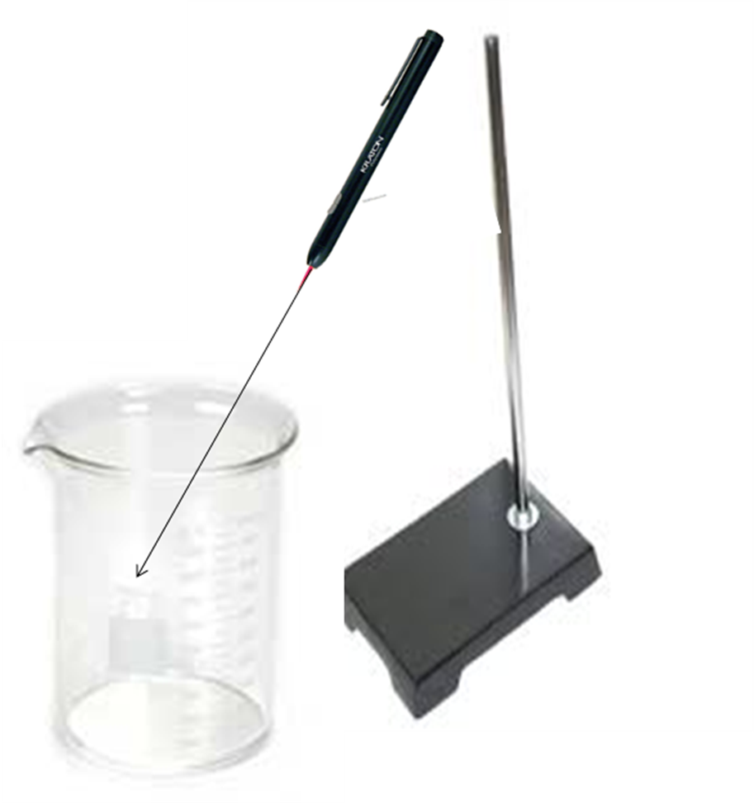
LAB: Refraction of Light—Part 1
Index of Refraction for H₂O
Procedure:
Set laser at 10-15º & use clamp to hold down laser button (unclamp the button when finished)
On vertical tape strip, mark un-refracted laser dot (Un) (caution: once set up don’t move beaker!!)
Fill beaker 2/3 full with H₂O & mark water line 1 (WL 1) & refracted line 1 (Re 1)
Add more H₂O and mark WL 2 & Re 2
h = Re to WL & h’ = Un to WL
Calculate n_{water} = h/h’ for both trials & % error
WL 2__
WL 1__
10-15º
Un ●
Re 1 ●
Re 2 ●

Slide 3
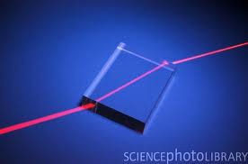
LAB: Refraction of Light—Part 2
Unknown = Plexiglas
Speed of light in Unknown
n = c/v_{s}
v_{s} = c/n = 3 x 10⁸ m/s = 2.05 x 10⁸ m/s
1.46
Explanation: This sketch shows…
Air
Unknown
NOTE: Use CLEAR not frosted sides and θ_{i} at the 1st interface & θ_{r} at the 2nd interface should be equal because both are air—If not you will need to do 2 Snell Law calculations and average the n’s!!!!
θ_{r} = 35˚
θ_{i} = 22.5˚
Unknown Index of Refraction
n_{i} sin θ_{i} = n_{r} sin θ_{r}
n_{i} = n_{r}sin θ_{r}= 1.000293 sin32˚ = 1.499
sin θ_{i} sin 22.5˚
θ_{r} = 22.5˚
θ_{i} = 33 ˚
Average Index of Refraction (Experimental)
(1.499 + 1.424)/2 = 1.46
Unknown Index of Refraction
n_{i} sin θ_{i} = n_{r} sin θ_{r}
n_{r} = n_{i} sin θ_{i} = 1.000293 sin33˚ = 1.424
sin θ_{r} sin 22.5˚
% Error Index of Refraction
|1.51 – 1.46| x 100 = 3.31%
1.51

Slide 4
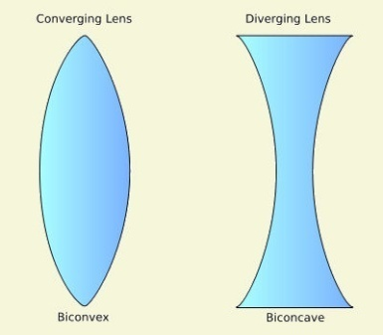
LAB: Refraction of Light—Part 3
1
3a
3b
4
5
Procedure:
As a group , trace the paths of the light rays through the different shapes
Test the shapes for reversibility (does it follow the same path back?)
Make summary table: shape, converging/diverging & reversibility
Lab report requirements:
Follow lab report handout for guidelines (I do not need it typed though)
Each part should have its own data table (or use data table provided)
Include Lab handout with tape on it from Part 1 (or on a blank sheet of paper)
Part 2 sketches: put your name, block material name, sketch description explanation, clearly labeled & diagramed & ALL calculations clearly shown: Vs, n’s & n_{ave} & % error (each person does a different unknown)
Part 3 Sketches: clearly diagramed & labeled & summary table
One Part 1 & Part 3 & conclusion & summary per group – Part 2 each person
2

